Slide 1
bREAKTHROUGH Sessions
Using Neuro Linguistic Programming and Hypnosis to break through the ceiling of our perceived limits

Slide 2
What is a breakthrough session?
If you have ever felt you are not living up to your true potential, that reaching your goals is always just out of reach, that your past is affecting your daily life, that you self-sabotage, that you’re not good enough, or that SOMETHING is holding you back, I have news for you…
That SOMETHING is YOU! However…
YOU are also the powerful force that can change all of it, simply by choosing to do things differently- by reconnecting with your unconscious mind, in a clear and structured manner. The breakthrough session was created to pinpoint and release these self-limiting beliefs, lower emotions – anger, sadness, fear, guilt and non-supportive habits that you have accumulated over a lifetime of experiences… quickly and easily, using Neuro Linguistic Programming and Hypnosis techniques. In this presentation, you will learn what this entails, how it works and what you can do right now to change the trajectory of your life…

Slide 3
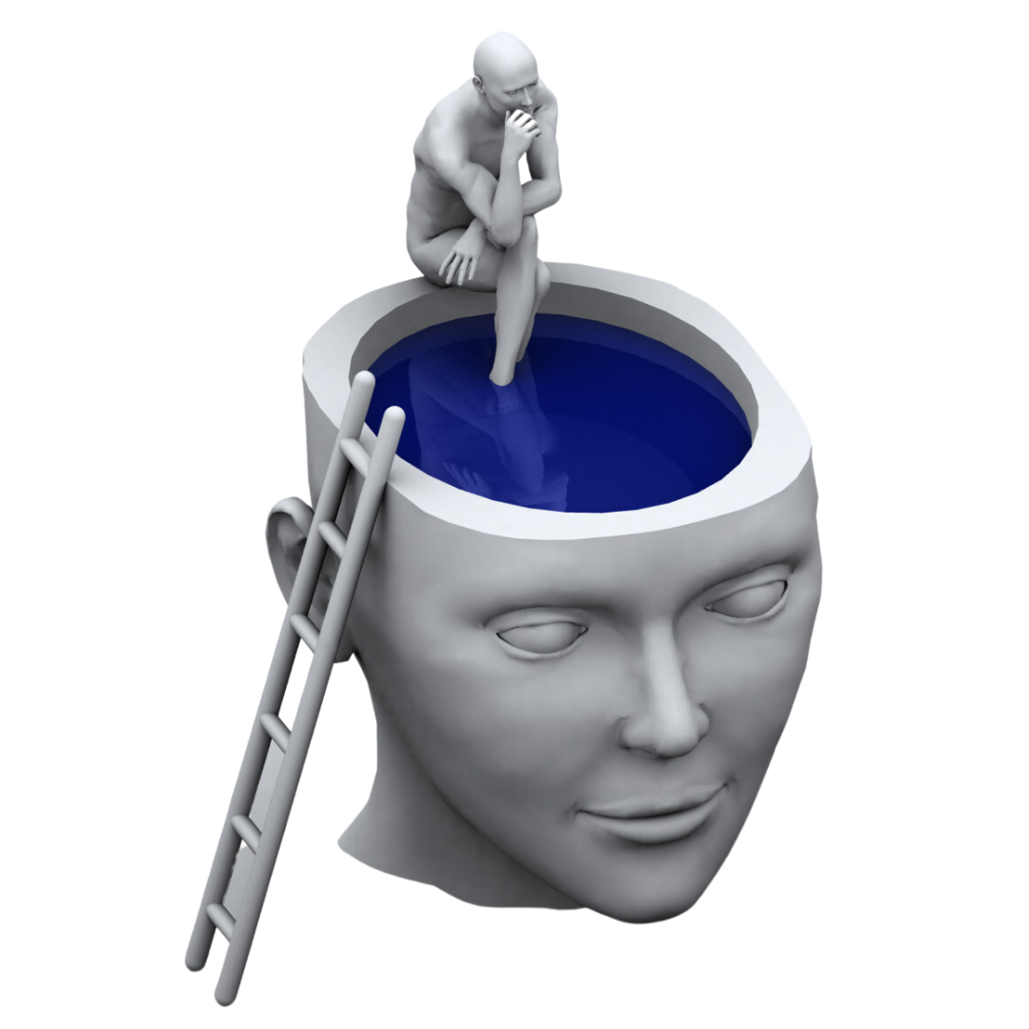
“I have tried everything…”
This is a response I see in my practice so often. “I have been to therapy for years and I still feel depressed and doing the same things”, or “I have tried EVERYTHING, NOTHING works”. And they have done what they believed they could- in terms of motivating themselves, going to therapy, taking medication or “tried” to think and analyze their way out of their situations. They’ve seen temporary, or no changes at all, in spite of putting in the effort, so why isn’t any of it working permanently? Because the filters of our conscious mind, creates distorted, unclear communication to the unconscious mind.
The UNCONSCIOUS mind is the place where real change and learning happens, the place where all our behaviors reside, the intermediary to the fulfillment of our every wish. Your wish is its command!
Making a conscious decision to change is the first step, however bypassing the conscious filters to access the unconscious mind will ultimately be the best way to permanently release what is not needed and create the positive outcomes we desire.

Slide 4
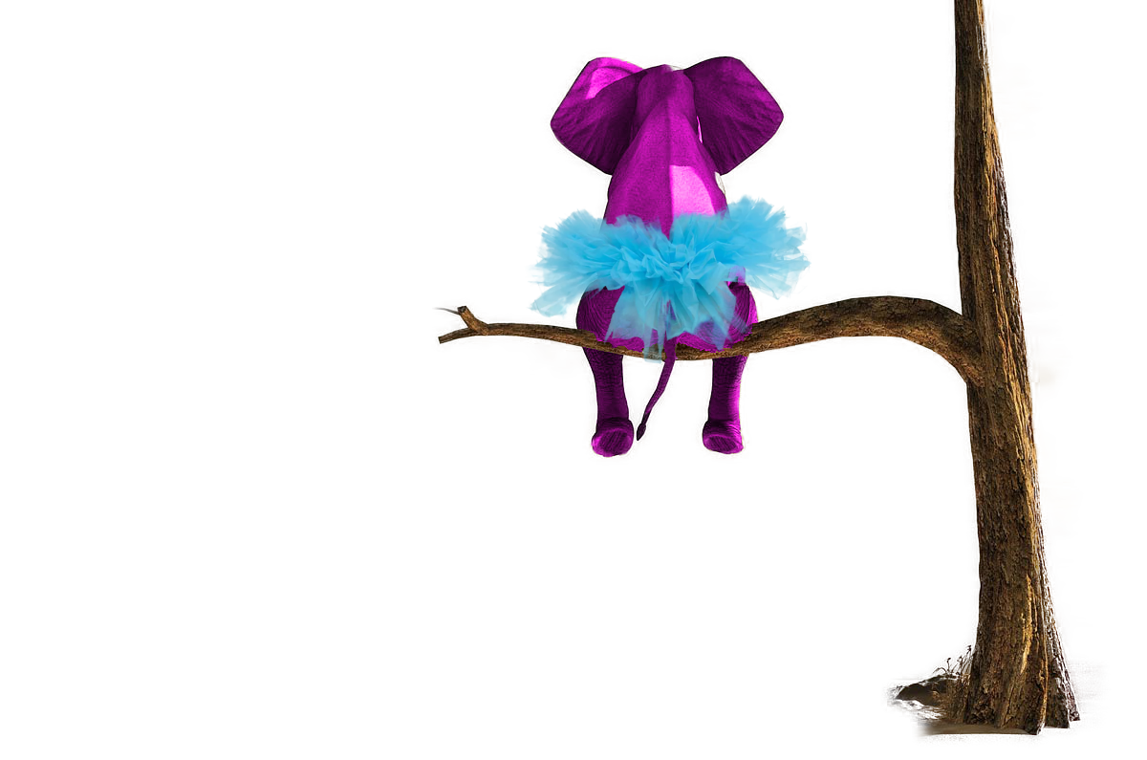
What is the difference between the conscious and unconscious mind?
Conscious Mind (10%)
Analyzes and categorizes information
Contacts reality through the sense organs
Thinks and plans, is aware
Perceives and presents information to the unconscious mind
Communicates with the universal consciousness (God) through the unconscious mind
Makes generalizations, is a decision maker and a judge, tests probabilities
Unconscious Mind (90%)
Prime directive is survival, to protect and preserve the body, keeping you alive
Runs habits and behavior programs, follows instructions from the conscious mind
Collects, stores and organizes memories
Direct connection with God / source/ wellspring, designed to give you what you want
Messages the conscious mind via emotions
Does not process negatives or grammar, translates words into symbols and pictures
What happens when I tell you NOT to think of a pink elephant climbing a tree wearing a blue tutu?

Slide 5
What is nlp and hypnosis?
Neuro-Linguistic Programming (NLP)
The psychology of success
Utilizing our neurology to produce self-talk and behaviors that generate successful results consistently and repeatedly.
Events are processed via our 5 senses, visual, audio, kinesthetic, olfactory and gustatory – “neuro”
The language and nonverbal communication faculties are encoded into pictures, words, sounds, self-talk, taste, smell and feelings – “linguistic”
Discovering, redesigning and changing the communication to actualize successful results – “programming”
Hypnosis
An awake state of relaxation
Utilizing the imagination
Exercise for the mind
Builds rapport with the unconscious mind
The ultimate display of control over oneself
All hypnosis is self-hypnosis
A powerful healing state
20 min of hypnosis is equal to 4 hours of sleep

Slide 6
What is the difference between a breakthrough session and therapy
Hypnosis with NLP is a wonderful natural and simple tool that brings immediate and permanent changes to the areas of your life that you feel needs changing. It releases old negative and non-supportive habits and replaces it with joy and happiness, quickly and easily. The breakthrough session has been developed to filter and identify low energy emotions, or “Potential Power Inhibitors” (PPI’s) and delete them, bringing about new thought patterns and balance between the physical, mental, emotional and spiritual systems. It facilitates self-healing for now and the future.
Traditional therapy by contrast does not clear negative emotions, but rather focuses energy on the events that caused the negative emotion to begin with, and because the unconscious gives you what you focus on, it becomes a recurring negative cycle. The communication between the conscious and unconscious remains distorted. A survey of psychotherapy literature revealed that psychoanalysis had a 38% recovery rate after 600 sessions, behavior therapy a 78% recovery after 22 sessions and hypnotherapy showed recovery of 93% after 6 sessions.

Slide 7
How does a breakthrough session work?
Breakthrough sessions can be anything from 4 – 8 hours long. In my experience the length of time depends on the willingness of the client to do the pre-work, prior to the session. Before I see any clients, I request a minimum of 3 pages, a write-up (no editing or lists) of their lives from childhood to now, focusing on traumatic events, negative emotions, phobias, limiting beliefs, relationships, money, career, health, anxieties and things that are not working in their lives etc.
How do you know if you have limiting beliefs? Because something in your life is not working. Limiting beliefs take a bit more time and that is where the bulk of time will be spent on. We use NLP techniques to pinpoint and reprogram the belief system, while negative emotions take around 2 minutes to clear. There is no dwelling on these events during the session, we pinpoint, change or release, doing different modalities throughout the day. It is a fun way of exploring your own inner world, learning about yourself and gaining a completely different perspective on life as a whole. You leave the session feeling great! My own breakthrough experience can be summarized in one sentence:
“Nothing changes, but everything changes”. My physical circumstances didn’t change during the session, however my entire life changed for the better…

Slide 8
What to expect in the session
Expect to be confused – confusion precedes change and my goal is to do just that! If you are confused, you are doing a great job! I use NLP techniques to elicit root causes and changing limiting beliefs, to give the unconscious mind the opportunity to find new solutions and create new pathways to success.
Expect to use your imagination, a lot. To create the life of your dreams, we use your imagination. You will create the suggestions you want your unconscious mind to follow and use it in your hypnosis, which is recorded for you to listen to every day after the session.
Expect to experience time distortion. I have had many people say the 6 hours in the session felt like 3 hours or less.
Expect to feel incredibly relaxed afterwards. A lot of change occurs during these sessions. The first night’s sleep is amazing!
Expect homework. The fun kind that solidifies the work you did during the session and sets the foundations upon which you will continue your journey of growth and creation. The unconscious mind LOVES repetition and you will love the techniques taught to deal with events that may have previously created less than ideal outcomes. Now you can transform these to opportunities in your brand new life.

Slide 9
What can I do today?
To make an appointment for your breakthrough session, contact me at Helene@eternalhealinghypnosis.com or visit my website at www.eternalhealinghypnosis.com.
There is no better time than right now to take control of your own life, create and manifest everything you dream of and live life filled with happiness, joy and peace in your heart.
I look forward to going on this journey of self discovery with you!

